Slide 1
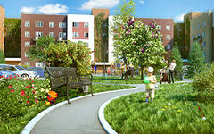
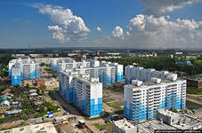
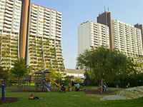
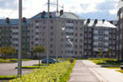
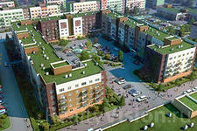

Slide 2
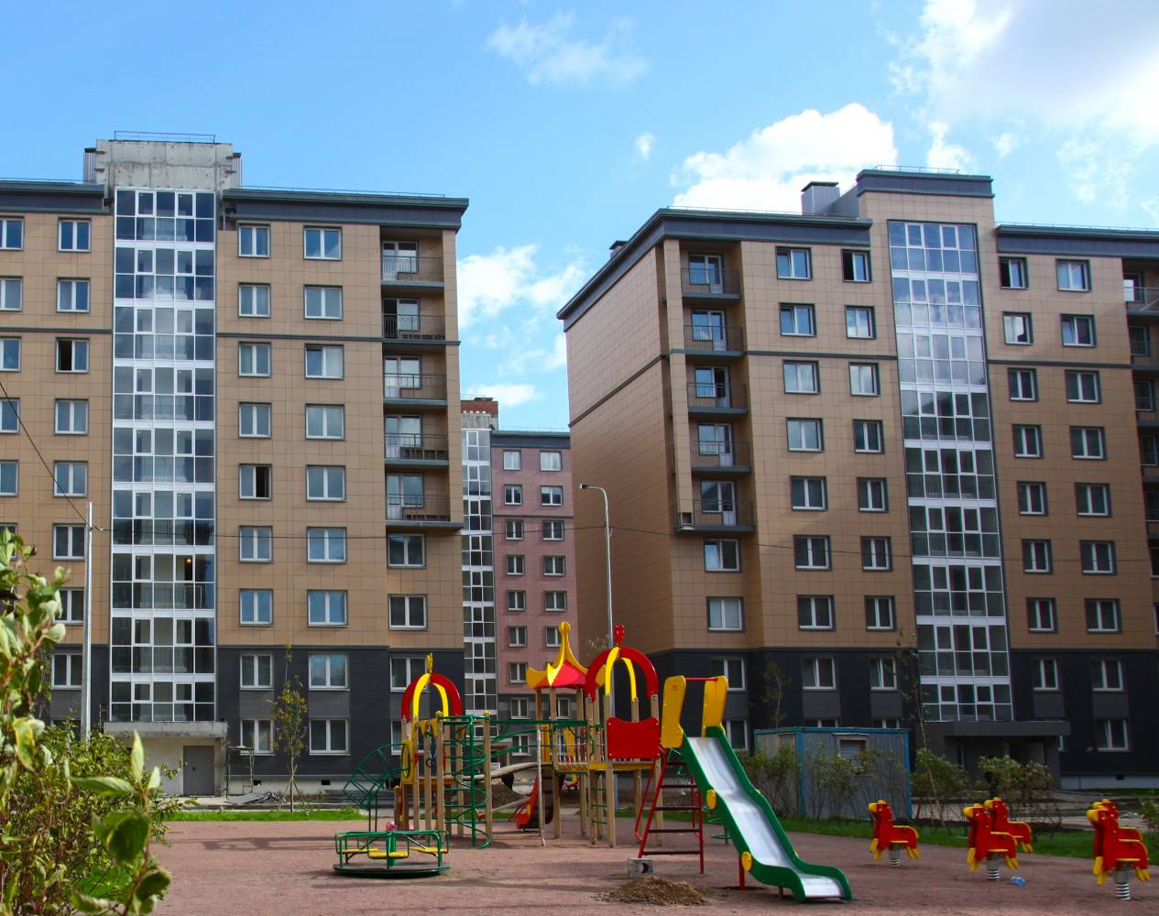
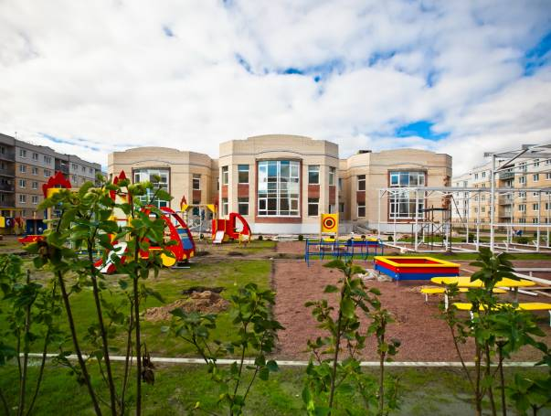
My Neighbourhood

Slide 3
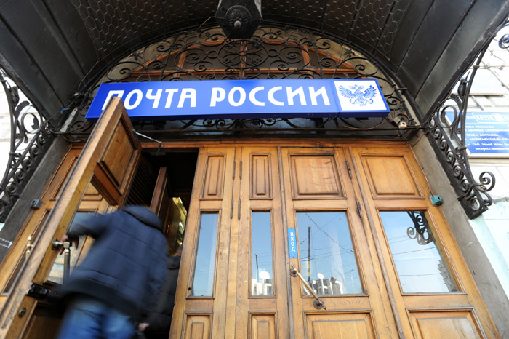
post office [pəust 'ɔfɪs]

Slide 4
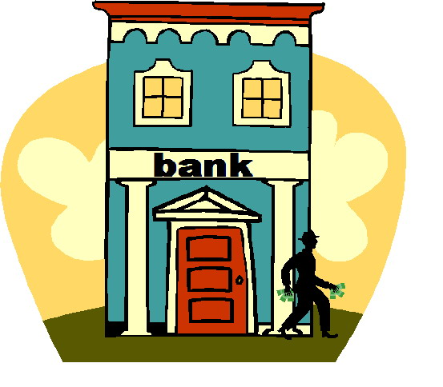
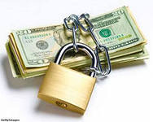
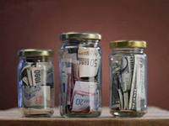
bank
[bæŋk]

Slide 5
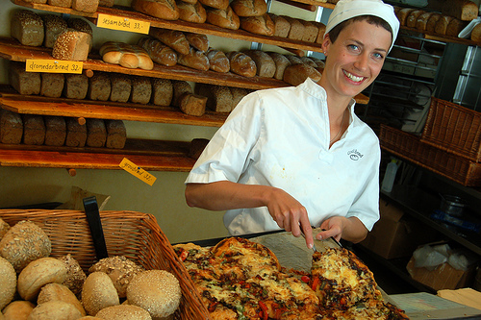
Baker’s ['beɪkəz]

Slide 6
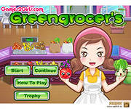
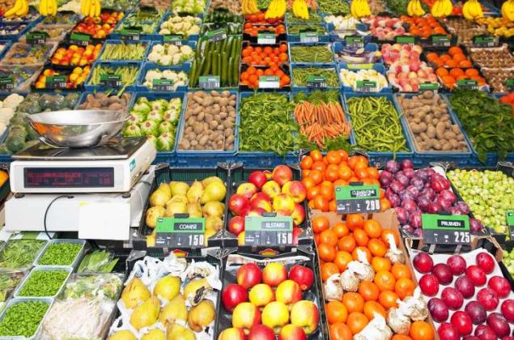
greengrocer’s ['gri:ngrəusəs]

Slide 7
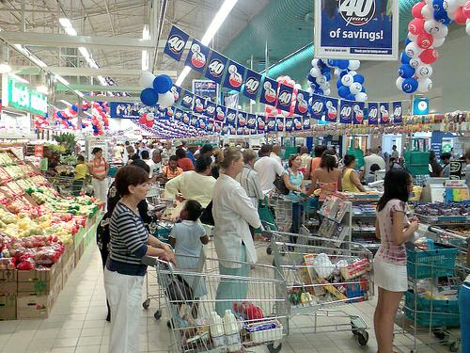
supermarket ['s(j)u:pə'mɑ:kɪt]

Slide 8
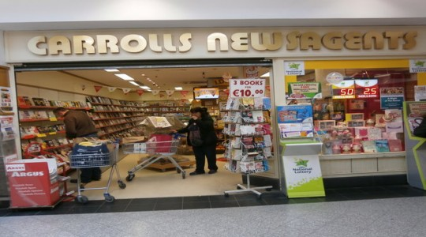
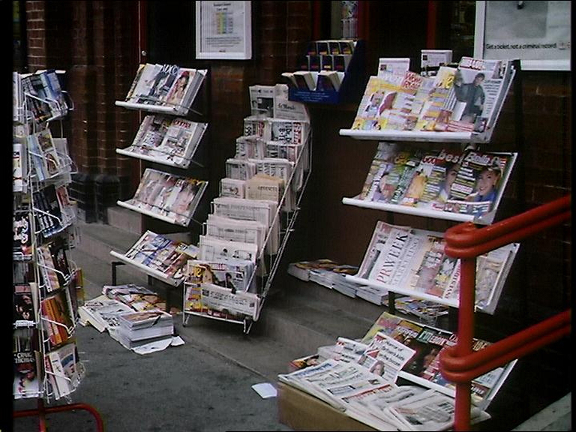
newsagent’s ['nju:zeɪʤ(ə)nts]

Slide 9
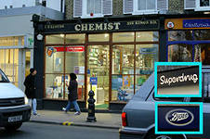
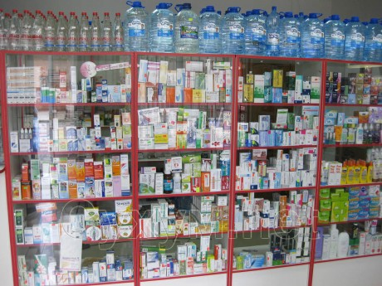
chemist's ['keməsts]

Slide 10
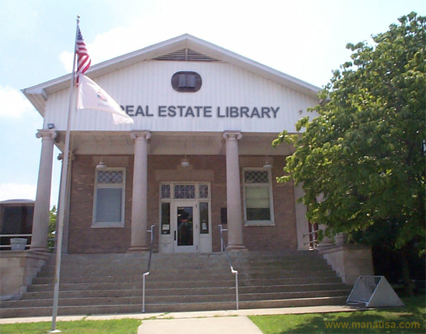
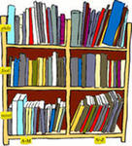
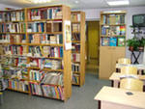
library ['laɪbr(ə)rɪ]

Slide 11
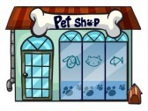
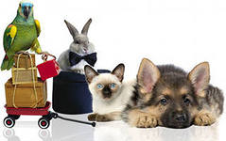
Pet shop [pet ʃɔp]

Slide 12
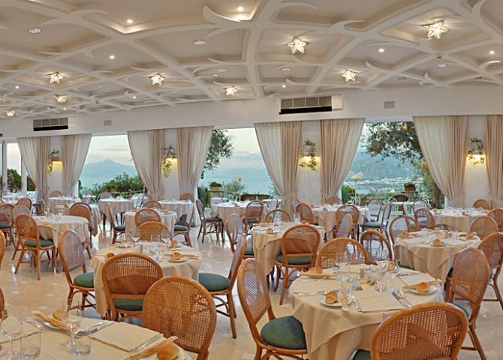
restaurant ['restərɔnt]

Slide 13
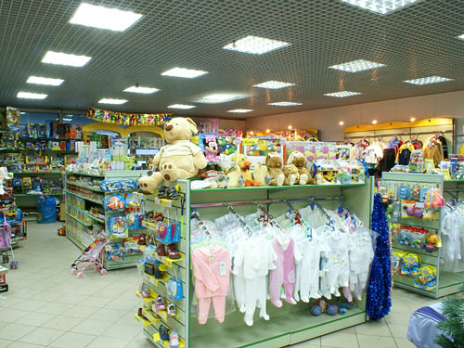
toy shop
[tɔɪ ʃɔp]

Slide 14
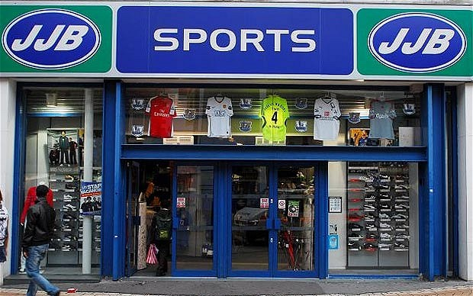
sports shop [spɔ:ts ʃɔp ]

Slide 15
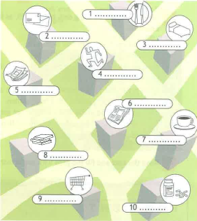
restaurant
post office
hotel
sports center
bank
newsagent”s
cafe
library
supermarket
chemist”s

Slide 16
I can buy a parrot at the pet shop.
Yes, you can. You can buy a parrot at the pet shop.
I can buy a teddy bear at the chemist’s.
No, you can’t. You can’t buy a teddy bear at the chemist’s. You can buy a teddy bear at the toy shop.

Slide 17
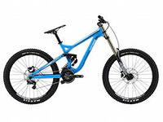
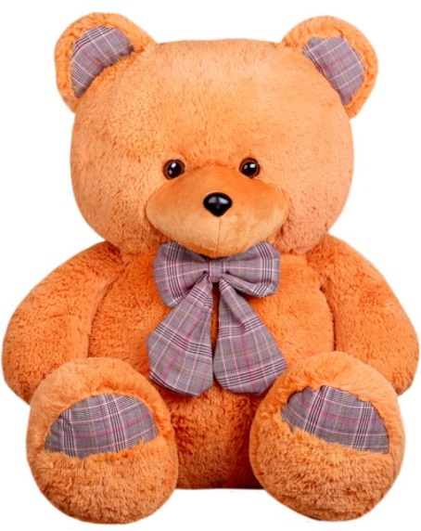
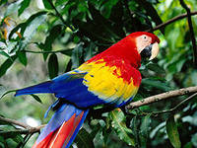
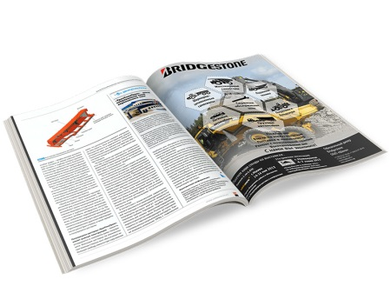
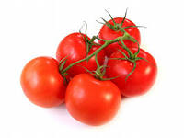
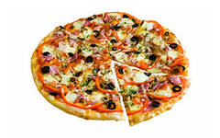

Slide 18
Newsagent's
2
4
1
Bus station
Library
Chemist's
3
Supermarket
Bank
Post office
5
Coffee shop
6

Slide 19
- What kind of neighbourhood do you live?
- I live in a beautiful neighbourhood.
- Is there a post office in your neighbourhood? Where is it?
- There’s a post office right next to the bank.

Slide 20
Your homework:
SB: p.20 ex.4

Slide 21
Thank you for your work!

